Slide 1

Poetry Dependency Manager
Justin Stone & Owen Guglielmino

Slide 2
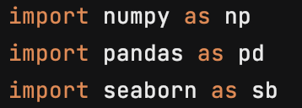
What is Poetry?
Poetry is a Python library that tracks and manages dependencies for your Python projects.
Dependencies are the packages we import into our scripts, like NumPy, Pandas, and Seaborn.
Poetry manages these packages by operating in a virtual environment that is separate from your system.

Slide 3
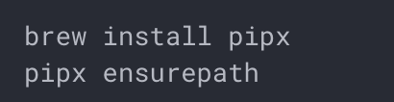
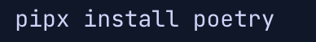
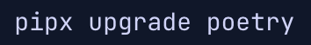
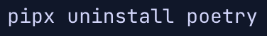
Installation
Poetry must be installed using pipx
Pipx is similar to using pip install. The key difference is that the package is installed to your system in an isolated virtual environment.
Use pipx just as you use pip install
Once pipx is installed, we can use it the same way we use pip for other packages.
Updating and Uninstalling
Updating and uninstalling Poetry is essentially the same as any other package.

Slide 4
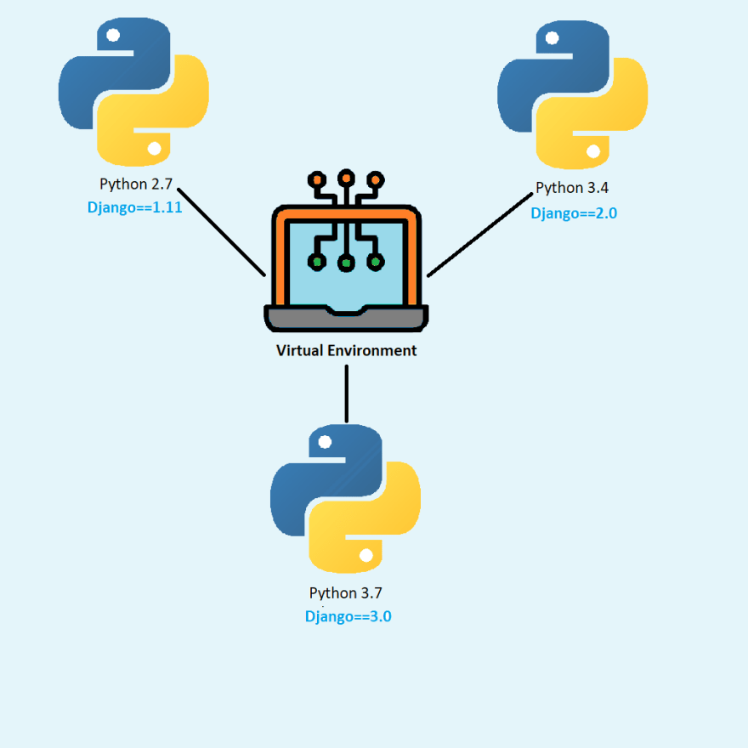
Virtual Environments
A virtual environment is a Python environment that is separate from your operating system.
Virtual environments allow for dependencies to be managed on a project-by-project basis, which prevents accidental errors across other projects
For example, project A might use Pandas functions that were archived in the latest release. If you update Pandas for use in project B, project A no longer works. Virtual environments prevent this!

Slide 5

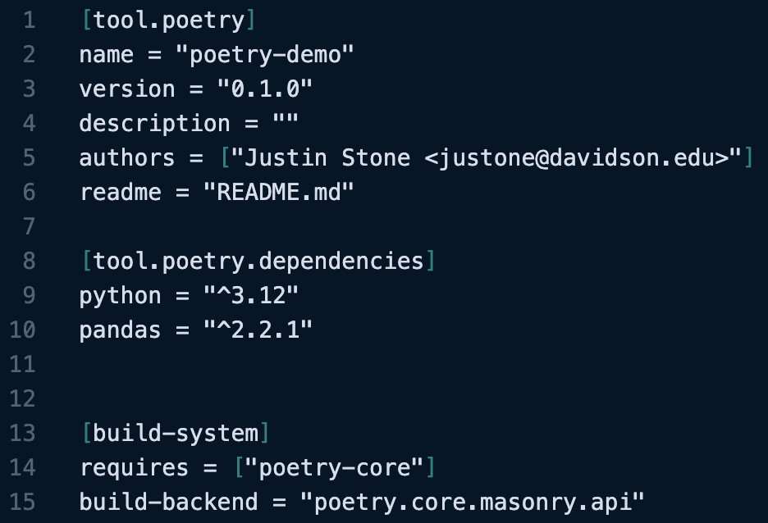
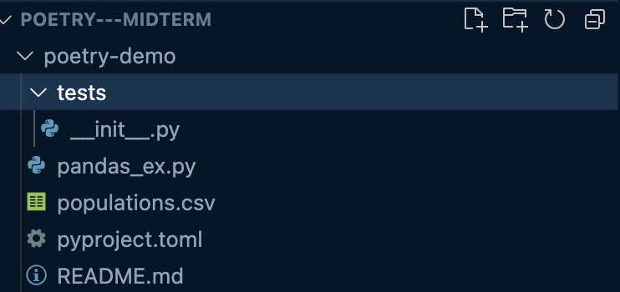
Dependencies
This section will update automatically as you add dependencies
When you create your first poetry project, a .toml file should appear in your directory
​
This is where you can track and manually add dependencies that poetry will install whenever the virtual environment is created
​
(You can also add dependencies automatically in your terminal and they will appear here!​)
​

Slide 6
Getting Started and Basic Usage
Start a Project
Poetry Add
Poetry Shell
Starting a Poetry project is done from the command line.
'poetry new' starts an entirely new directory for your project. 'poetry init' can be used to initialize poetry in a pre-existing project directory.
This command allows users to automatically add dependencies to the project.
The specified packages are added to a .toml file in the working directory. Poetry reads packages to be installed from this file.
The shell command is used to activate your project's virtual environment. Once this command is run, the environment is active and ready to run your project.
To deactivate the environment, just type 'exit' at the command line.
$ poetry new <project_name>
$ cd <project directory>
$ poetry init
$ poetry add numpy
$ poetry add pandas
$ poetry shell
$ exit

Slide 7

Running Files in Poetry
Poetry Run
Poetry Run
Using 'poetry run' executes the following command within the activated virtual environment.
Alternatively, if you define a .py file within your project's .toml, you can run it by name.
Define the file in the .toml:
[tool.poetry.scripts]
my-file = my_module:main
Run the file from the command line:
$ poetry run python my-file.py
$ poetry run my-file

Slide 8

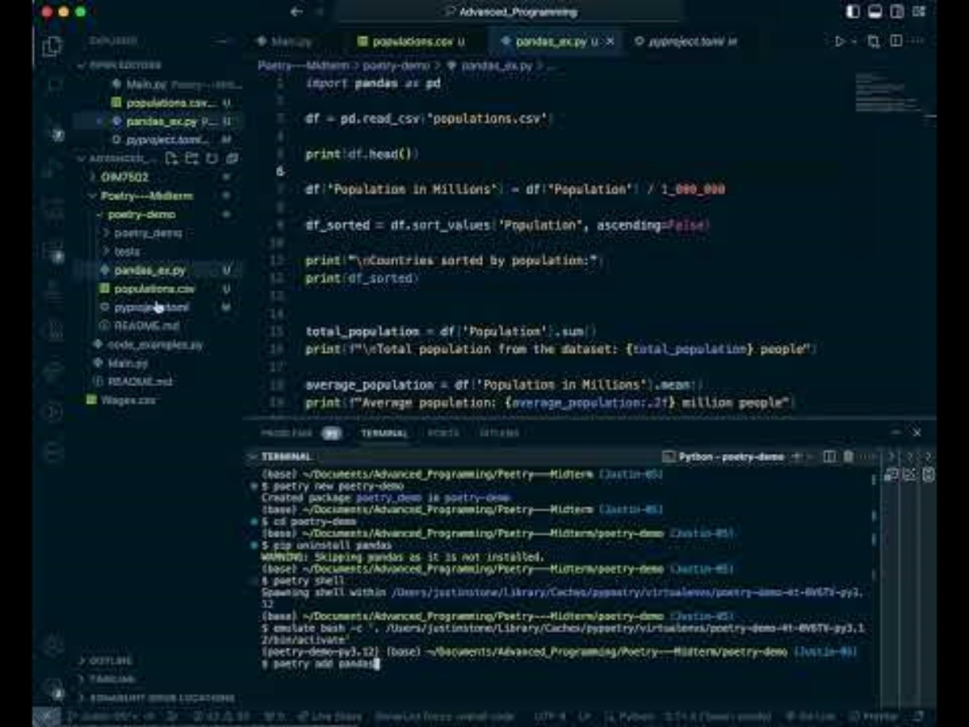
Poetry Walk-Through

Slide 9
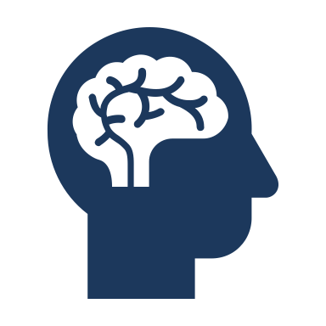

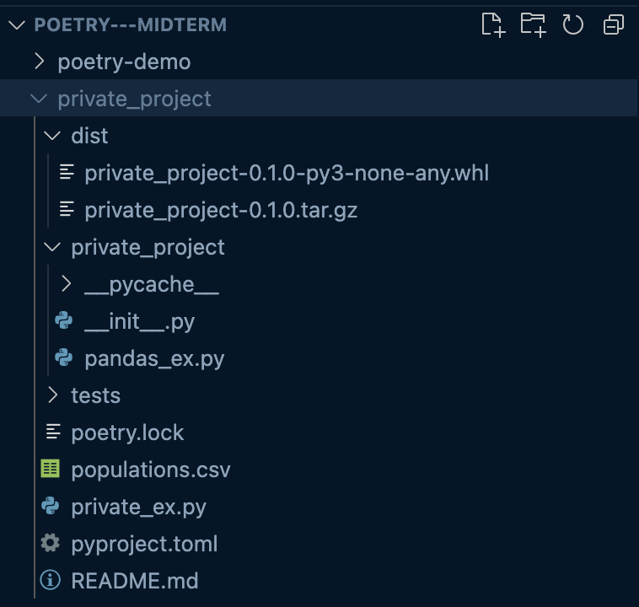
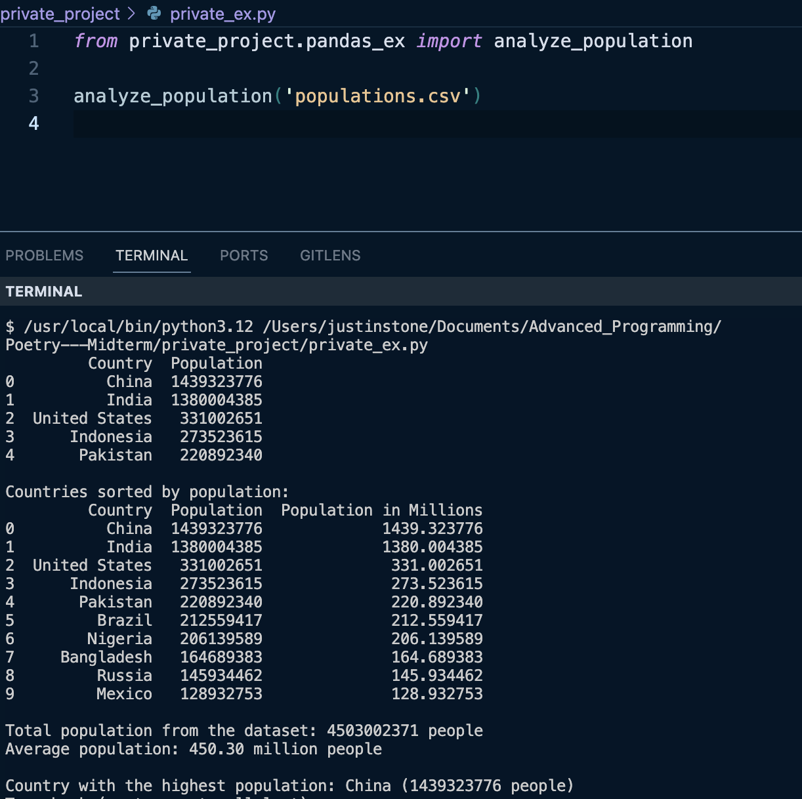
Sharing Python Code Globally
Steps
Start a new poetry project!​
Move python file into packages directory​
poetry add any necessary dependencies​
Run poetry build​, poetry will create a new folder called dist
pip install .whl file
Publish your package to a package index like PyPi
Keep the package secret by creating a GitHub repository and setting it to private

Slide 10



Why is this useful for Data Science?
Seamless teamwork
Poetry allows for data scientists to collaborate without wasting time fixing errors and managing packages.
Safe workspaces
Operating within a virtual environment contains your project and allows for isolated testing away from the rest of your system.
Easy custom packaging
Using Poetry's build function allows users to create reusable and custom functions.

Slide 11

To recap...
Virtual Environments
No more pip install
Allows for isolated coding and testing
Installs libraries exactly when and where you need them
Poetry
Dependency Manager
Custom packages
Collaboration
Users can create custom packages tailored to their exact needs
The same project can be run on different machines seamlessly

